Slide 1
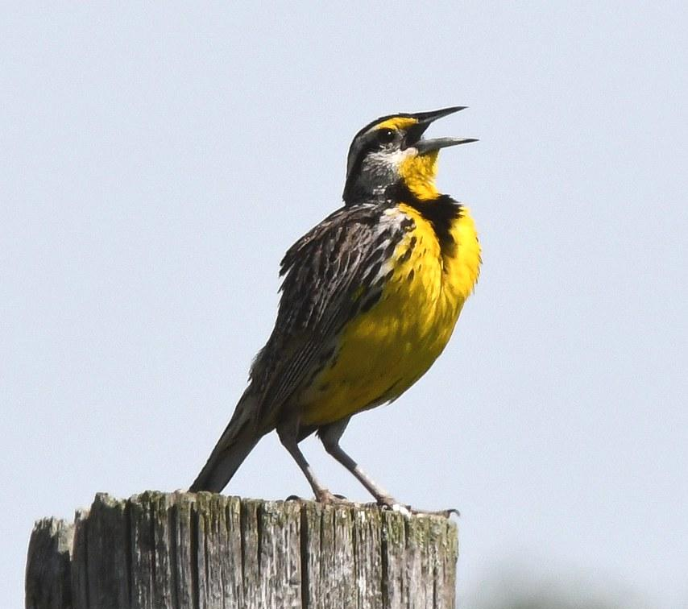
WILDLIFE AND PEOPLE
AT HUGHES STADIUM
Becca Windell
Colorado State University

Slide 2
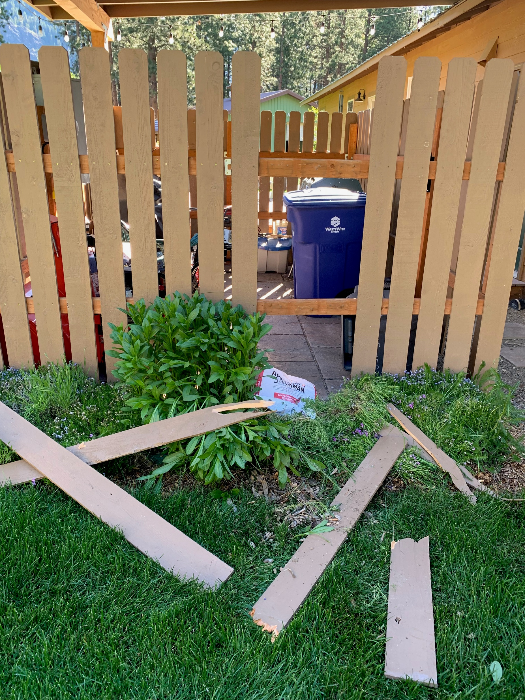
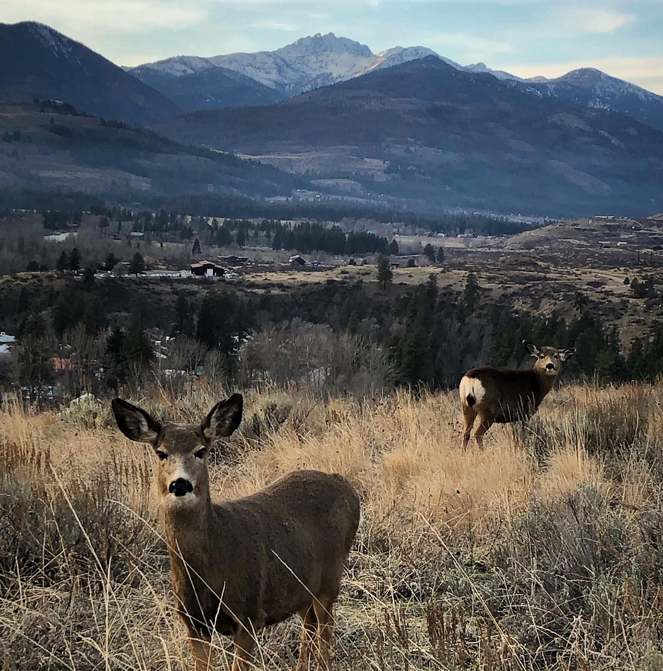
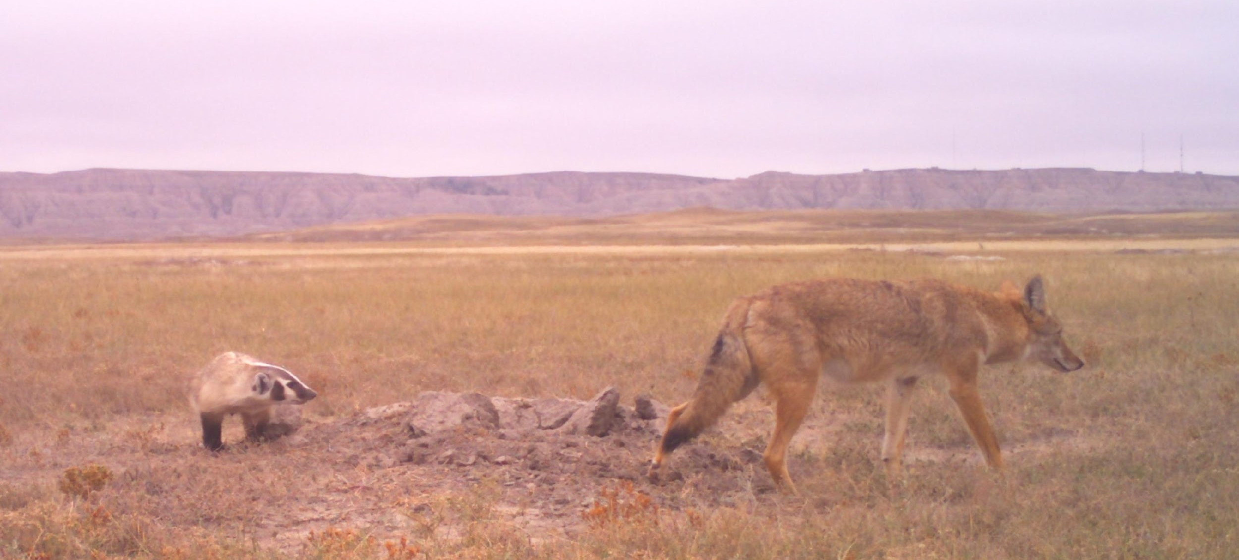
ABOUT ME
Animal behavior x conservation challenges
Human-carnivore coexistence
Wildlife-recreation dynamics
Species interactions
Disease dynamics
Notes:
Wildlife biologist, currently working on my PhD at CSU – broad interest in questions of animal behavior and conservation
I’m viewing my roll here as sharing a bit about wildlife and their responses to humans, and really encourage discussions about the specifics with folks from fort collins natural areas – they are the boots on the ground land managers
I also chatted with a few of my colleagues at CSU and they mentioned that figuring out best uses could be a master’s project, so this is hitting some of the high notes and will hopefully fuel thoughts on out to develop Hughes with both people and wildlife in mind

Slide 3
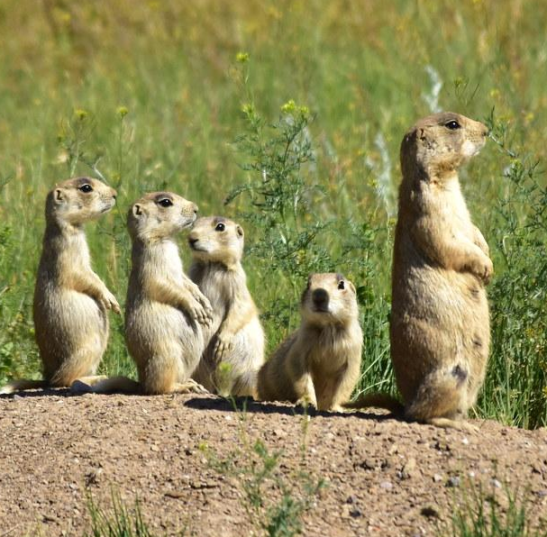
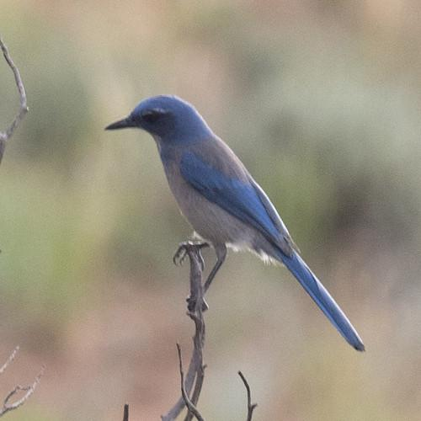
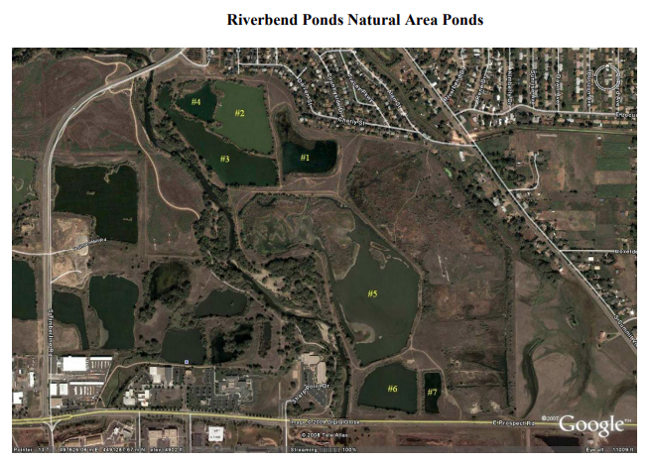
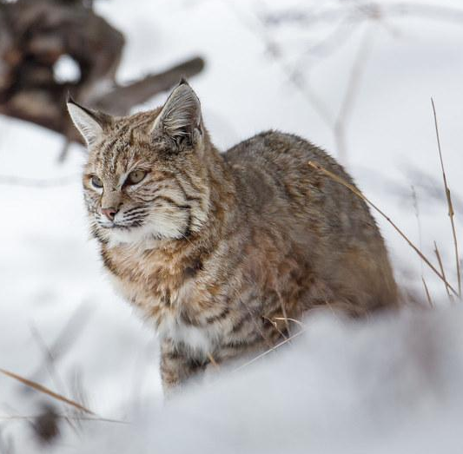
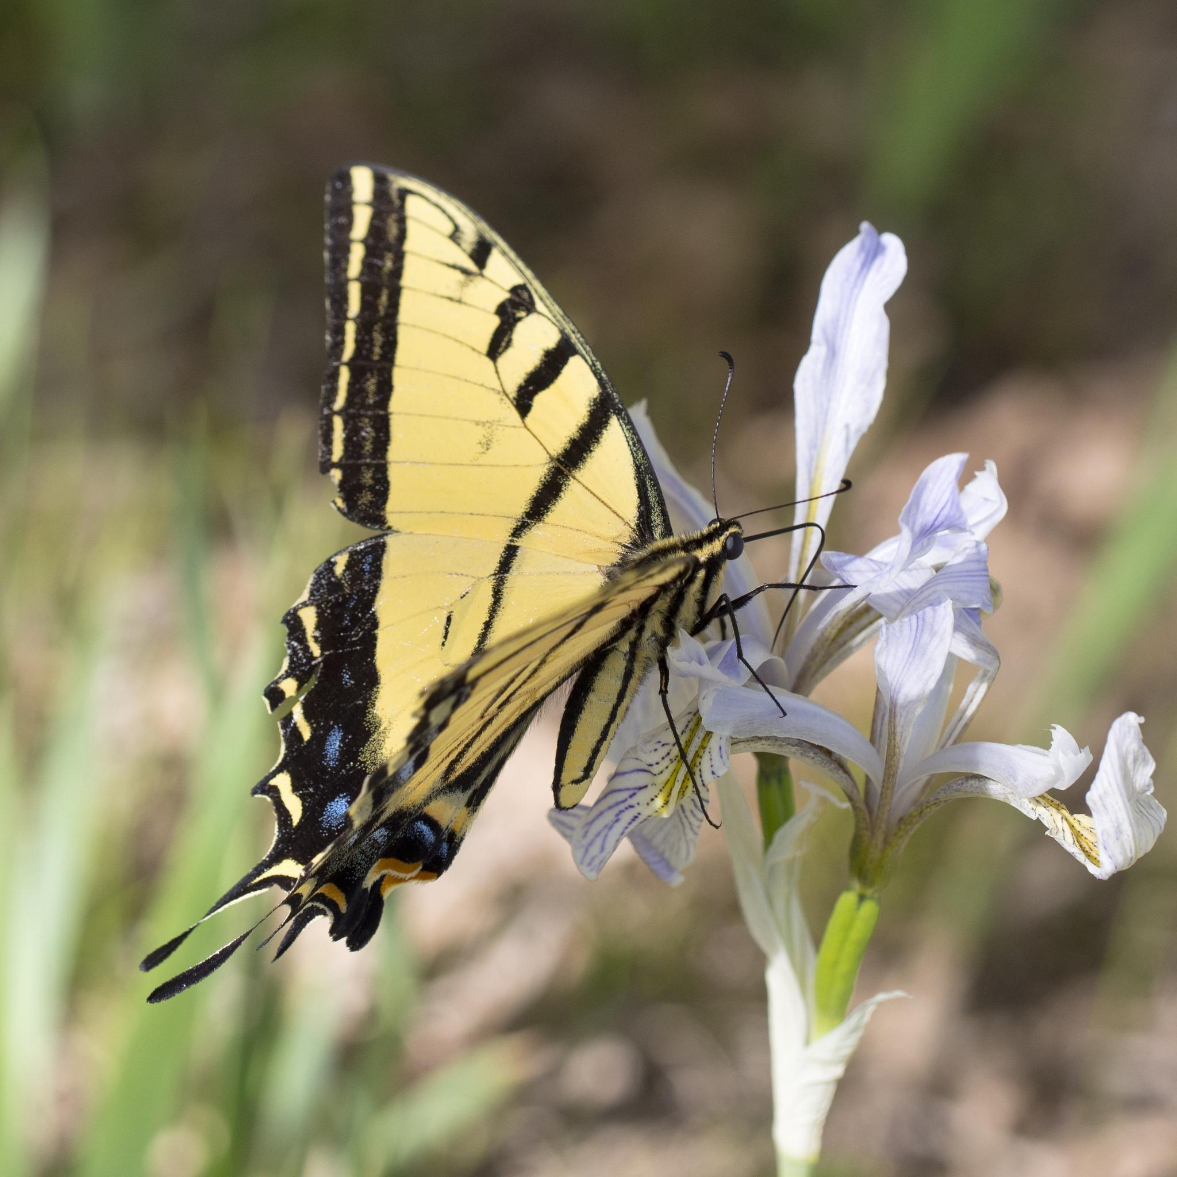
FORT COLLINS WILDLIFE AND COMMUNITY
Notes:
Lots of amazing wildlife in and around the fort collins areas, pds, woodhouse scrub jays, and two-tailed swallow tails
Hughes isn’t the first highly impacted site that the city as acquired and turned into something pretty amazing for wildlife and the community
Riverbend ponds natural area is a network of former gravel mine ponds which included ample fishing opportunities, 3 miles of walking/running trails, and are designated by the Audobon society as an Important Bird Area

Slide 4
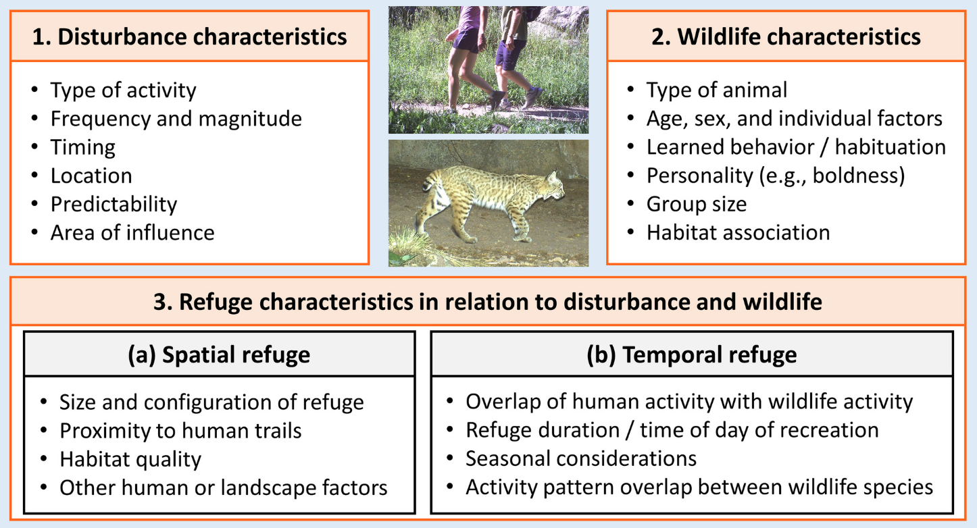
HUMAN DISTURBANCE AND WILDLIFE ADAPTATIONS
McKinney 2006, Biological Conservation
Urban avoiders
Abert’s squirrel, bobcat, mountain lion
Urban adapters
black bear, coyote, mule deer
Urban exploiters
fox squirrel, red fox, striped skunk
Lewis et al. 2021, Ecosphere
Notes:
Expanding body of scientific literature on wildlife living in proximity to humans, and we’re lucky that a lot of this work has been done either right in our back yard or elsewhere in Colorado
Highlight Jesse’s study, each of the 3 boxes
Broad categories of how animals respond

Slide 5
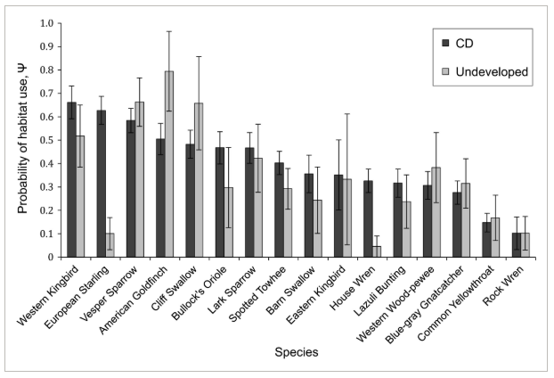
CONSERVATION DEVELOPMENT
Dertien et al. 2021, Nature Conservation
Farr et al. 2017, Ecological Applications
Notes:
Another study I want to highlight, which was again conducted in Colorado, highlights probability of habitat use in areas that underwent planned conservation development – incorporating carefully designed wildlife habitat into residential housing developments in comparison to undeveloped areas
Response was species dependent but in many cases, species thrived in conservation development areas which highlights opportunities to do just this at Huges

Slide 6
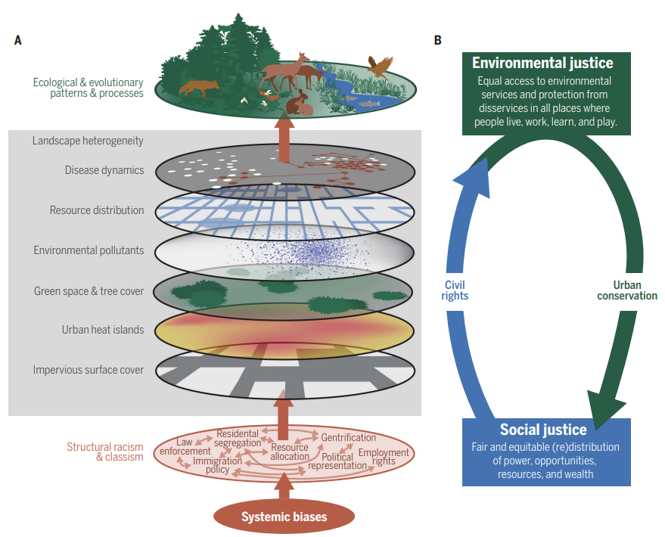
CONNECT EVERYONE TO NATURE
Schell et al. 2020, Science
Notes:
Final point I want to bring up is the immense importance of connecting everyone to nature as this is really were maximum conservation outcomes can be drawn from Hughes. Its important to recognized that the amount of green space and human uses are only a couple of the elements shaping ecological processes on the landscape, and I truly believe that the more we can leverage opportunities like this to provide access and opportunity to experience nature to everyone in our community, the more hope I have for long term conservation of not only fort collins, but our planet.

Slide 7




A VISON FOR HUGHES
Advocate for multiple, shared uses for people and wildlife
Strengthen connection and access to the outdoors and nature
Minimize disturbance to areas restored to support wildlife
Work with Fort Collins Natural Areas Managers
Notes:
Shared, multiple use: Build community! Think about configuration carefully
Connection and access: Bus stop, IDEA, gazebo to host things like nature summer camps or get school kids outside
Restore select areas and minimize disturbance: Trailed use where possible, no-mow, close at night to create temporal refugia, activity-specific areas – walking only trails near wildlife habitat to provide wildlife viewing opportunities…
Lots more literature on this to help plan to maximize habitat quality and minimize disturbance
FCNA: Best understanding of wildlife uses of the land adjacent to Hughes

